Slide 1
Computer Science
An introduction

Slide 2
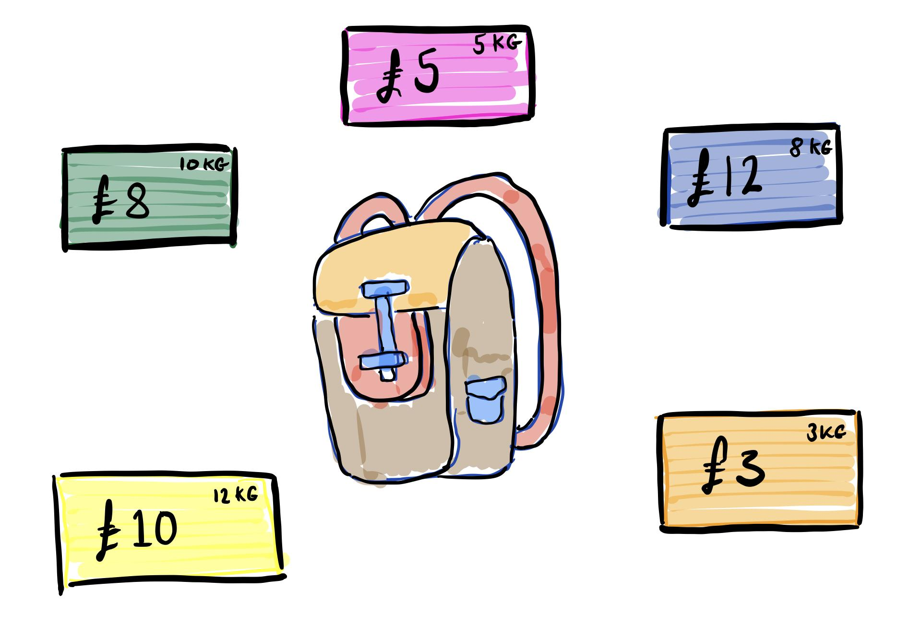
Backpack problem
Max weight 20kg
What is the greatest value (£) that can be made?
Boxes may be used multiple times

Slide 4
Cars
Heating controls
Social media feeds
Search engines
Sat nav
Music recommendations
Helping judges sentence criminals
Algorithms are everywhere

Slide 7
Algo trading

Slide 8
What is the Reddit Algorithm?
Reddit uses a story algorithm, meaning the number of votes and submission time of links have the biggest impact on how stories rank on the platform.
Also ranks items by the number of votes accumulated, as well as the age of the post compared to others.
Making the front page always appear fresh to a new user.
Reddit algorithms are written in Python

Slide 9
How the TikTok algorithm works
It serves users posts they engage with…
The strongest ranking indicator in this category, however, is the video completion rate.
It is more likely to push content that a user explores so more likely to see videos with the same hashtag and sound.
users’ location, language preference, and device type also play a role

Slide 10
Question
During an average day, what is your interaction with algorithms?

Slide 11
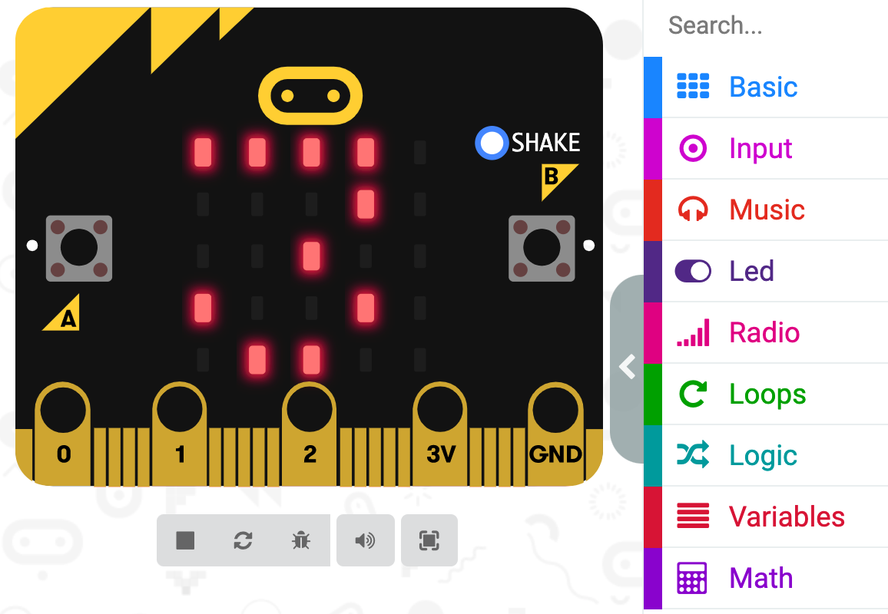
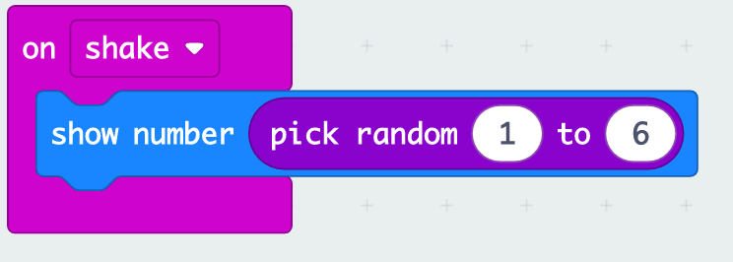
Apply. block vs text based coding

Slide 12
Levels of abstraction
High-level languages
Binary patterns ( 0101000101001) known as machine code

Slide 13
Key terminology and concepts
Command or statement
Sequence
Selection (branching)
Iteration
Bug testing

Slide 14
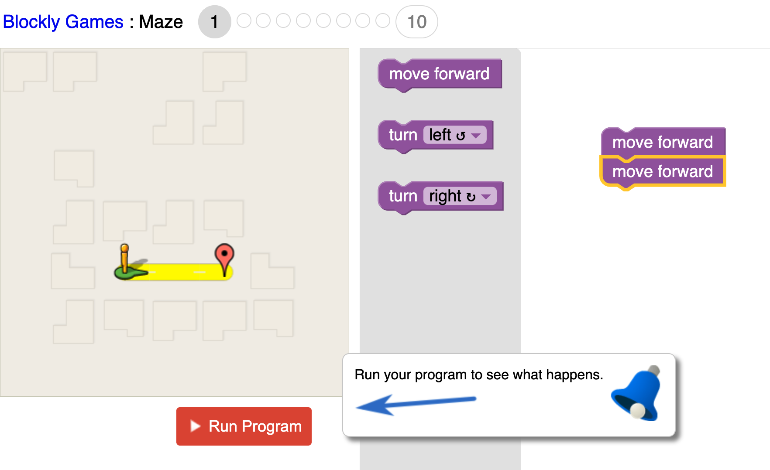
Search “blockly games maze”

Slide 15
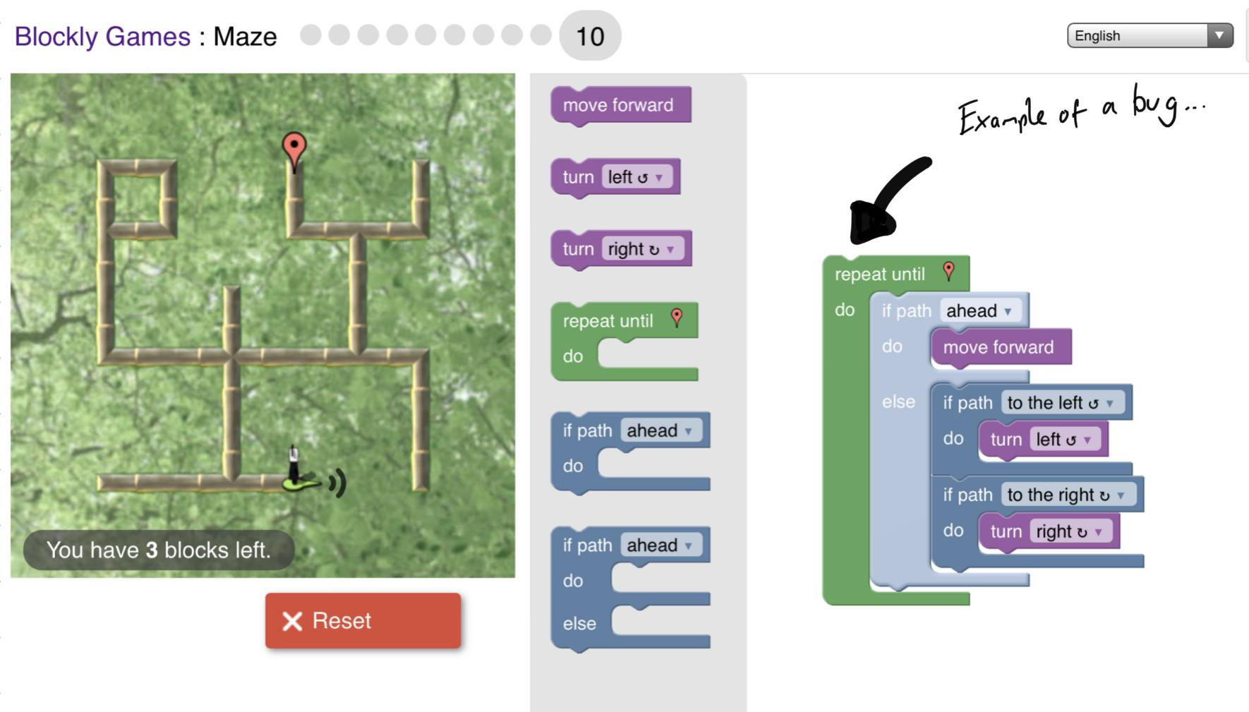
bug

Slide 16
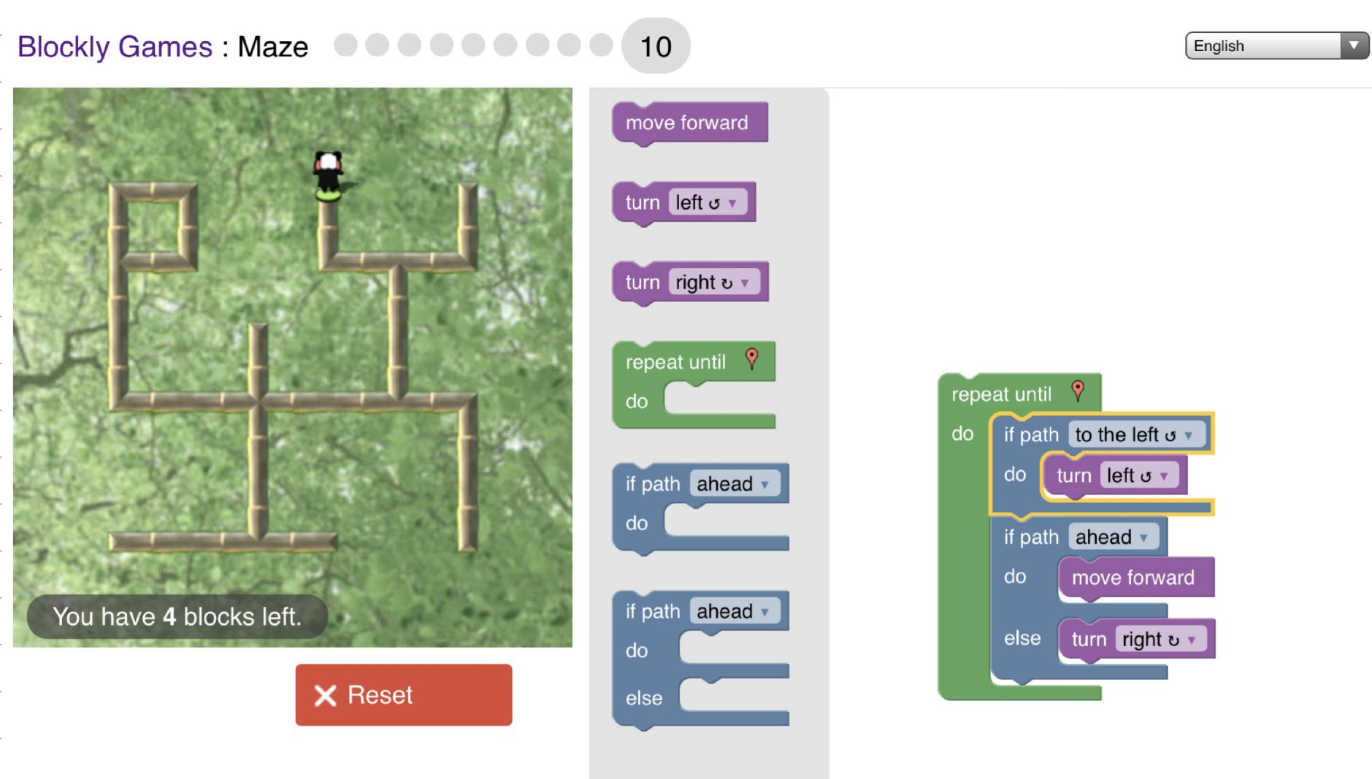
Challenge 10 solution

Slide 17
wash-up
Computer Science is most commonly taken at A-Level with Physics, Mathematics, Further Mathematics and Economics
Algorithms are ubiquitous, influential and demand ethical debate
High-level languages, whether Block, Python or C allow us to focus more on the computation - abstracting the low level working
Finally remember, be careful naming things, did Grace Hooper think a dead moth shorting a relay in 1971 would be used by millions of programmers 50 years later?

Slide 18
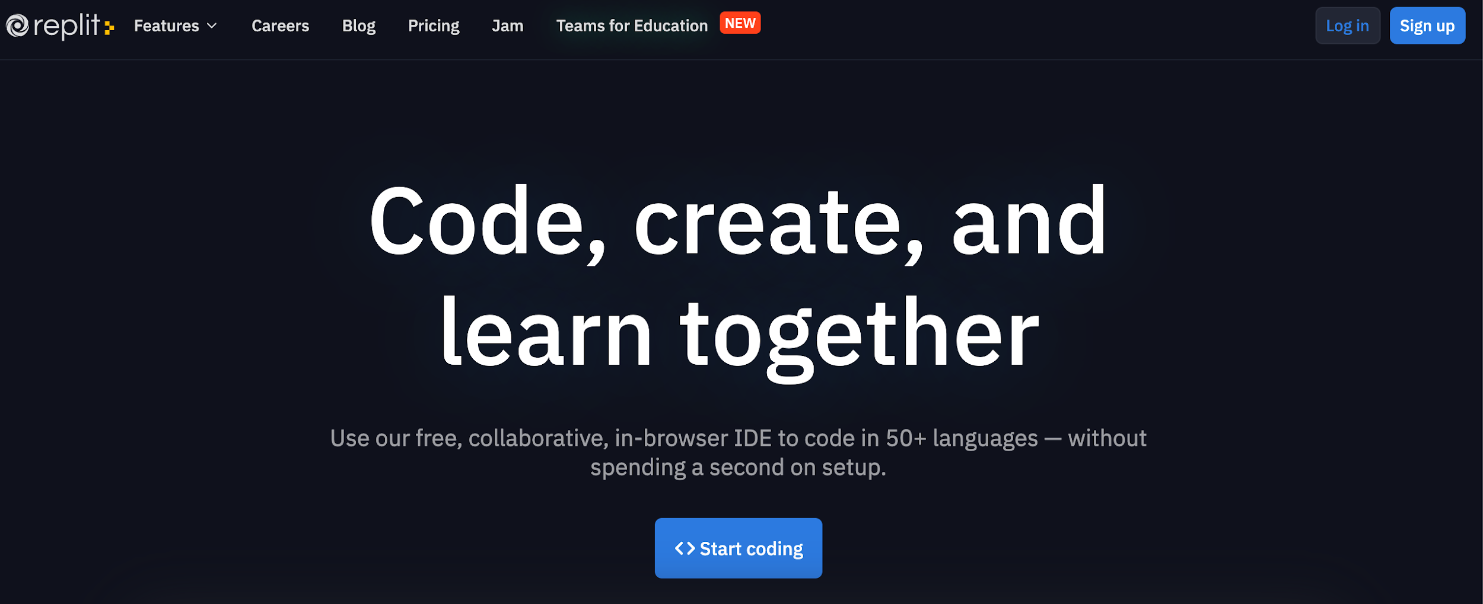
Writing a function in python*
*If time permits

Slide 19
Function in Python
# simple function, takes in side length as input
def areaOfASquare(side):
return side*side
# call and use function, printing result to screen
print(areaOfASquare(10))

